Slide 1
SMIS – A School Management Information System
Mihal Brumbulli
Polytechnic University of Tirana
Faculty of Information Technologies

Slide 2
☺
Introduction
Motivation
System Development
Conclusions
Mihal Brumbulli

Slide 3
Introduction
A School Management System is a large database system which can be used for managing school's daily work.
It is configurable and can be configured to meet most individual school's needs.
It is a multi-user system and can be used by hundreds of users at same time.
General speaking, it is platform running on a Local Area Network (LAN).
Mihal Brumbulli

Slide 4
☺
Introduction
Motivation
System Development
Conclusions
Mihal Brumbulli

Slide 5
Motivation (1)
Albanian Government is working on a developed strategy which aims the development of ICT structures in all the high schools of the country.
Most of the high schools are already equipped with necessary hardware and network structures under the supervision of the Ministry of Education.
Open issue:
  Managing the information electronically.
Solution:
  School Management System
Mihal Brumbulli

Slide 6
Motivation (2)
Goals:
  managing information on students,
  employees,
  teaching processes
  etc...
Initiative of a Professional High School in Albania and the support of European Union.
Mihal Brumbulli

Slide 7
Introduction
Motivation
System Development
Conclusions
Mihal Brumbulli

Slide 8
System Development
☺
Analysis and Definition
Design
  Data Model
  Software Model
Implementation
Mihal Brumbulli

Slide 9
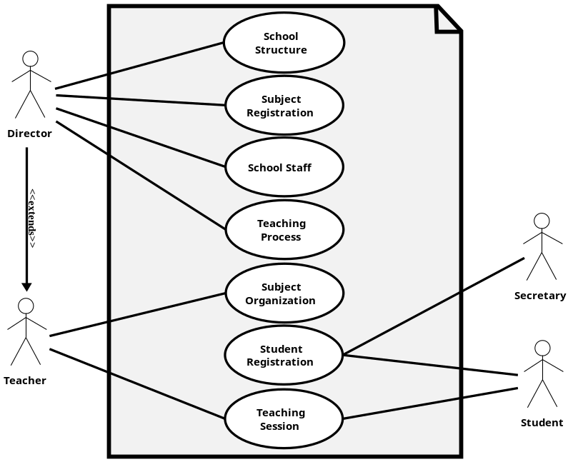
Analysis & Definition
The requirements specification document was created.
Existing documents were a good reference.
Mihal Brumbulli

Slide 10
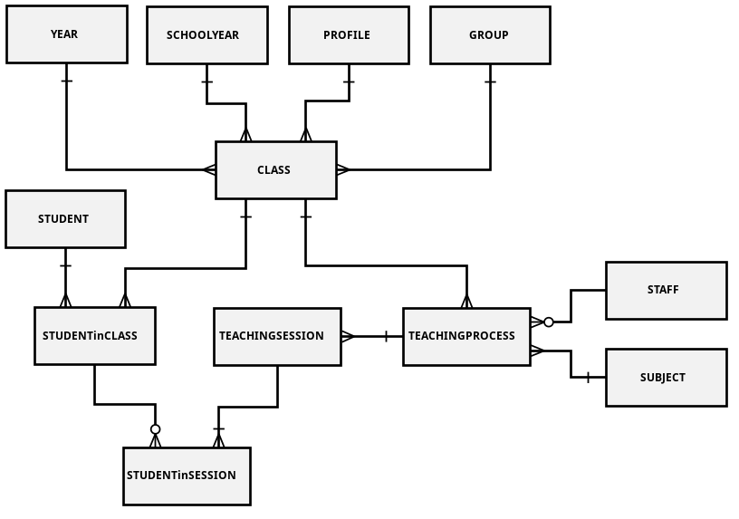
Design (Data Model)
We made decisions regarding how best to take the system in the real world and model it in a database.
A well-designed database takes time and effort to conceive, build and refine.
Mihal Brumbulli

Slide 11
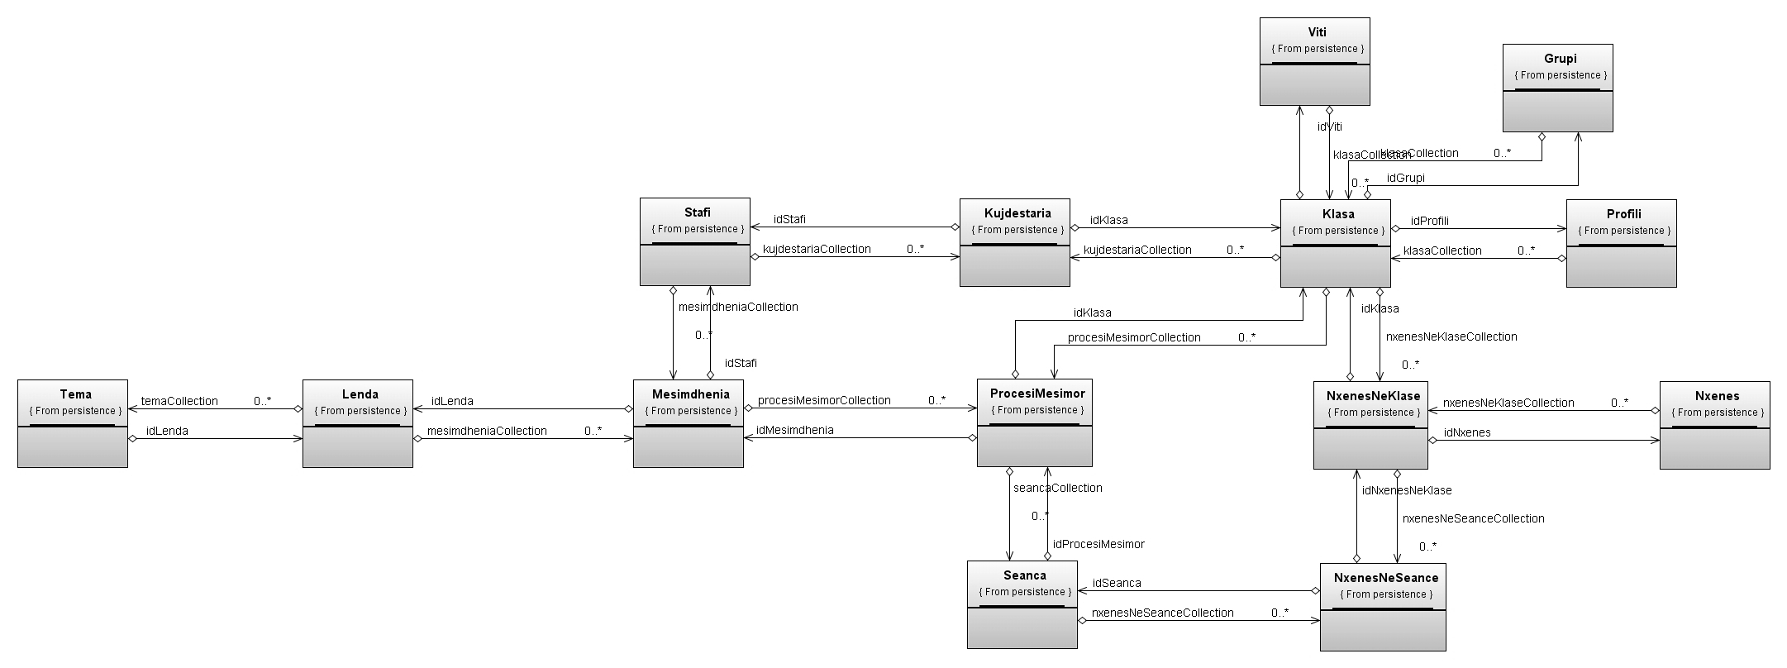
Design (Software Model)
Object-Oriented Modeling technique.
Designed in order to define a good ORM.
The model better describes interactions and relationships between objects representing real life entities.
Mihal Brumbulli

Slide 12
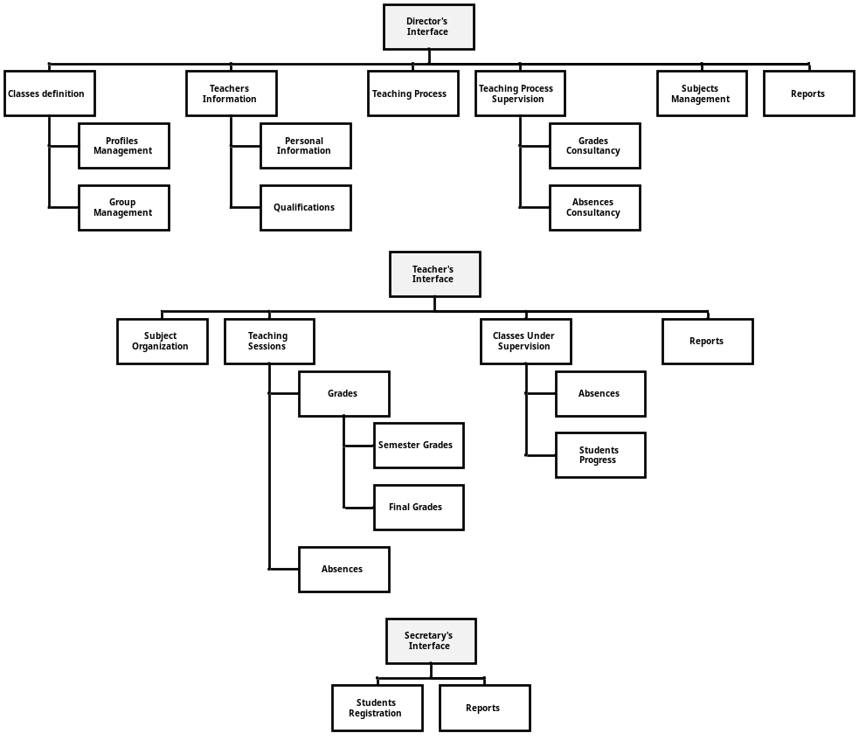
Implementation
3 levels of users with different rights upon the data/information that can be stored, retrieved or modified:
  Director
  Teachers
  Secretary
Mihal Brumbulli

Slide 13
☺
Introduction
Motivation
System Development
Conclusions
Mihal Brumbulli

Slide 14
Conclusions
The need of managing the information electronically is growing rapidly in all important areas in Albania.
School Management Systems are being identified as an appropriate method for managing information in schools.
SMIS was built based on real life situations in Albania’s high school, taking into consideration all possible situations and functionalities of the daily work in these schools.
This system maybe considered as a good first step in implementing performing electronic based information management in schools.
Mihal Brumbulli

Slide 15
Thank You!
☺

